Slide 1
Disease Prediction
Using Machine Learning
By
Dwij Joshi (200050131068)
Anushka Mahajan (200050131074)
Branch: Computer Science Engineering
Div:2

Slide 2
Introduction
About Data Sets
Libraries Used
Algorithms Used
Pre-processing Data
Things Analysed from Datasets
Prediction
Comparisons of different Algorithms
Conclusion

Slide 3
Introduction
Multiple Disease prediction is done using the dataset of 4 different diseases like heart disease, kidney diseases, breast cancer and diabetes.
We have used 3 different algorithm for the prediction and comparison of these algorithms accuracy is also measured.
The algorithms used are :
Decision Tree
K Nearest Neighbors(KNN)
Logistic Regression
We have used following datasets:
https://www.kaggle.com/datasets/johnsmith88/heart-disease-dataset
https://www.kaggle.com/datasets/mansoordaku/ckdisease
https://www.kaggle.com/datasets/mathchi/diabetes-data-set
https://www.kaggle.com/datasets/uciml/breast-cancer-wisconsin-data

Slide 4
About Data Sets
About Heart Disease Dataset:
Attribute Information:
age
sex
chest pain type (4 values)
resting blood pressure
serum cholestoral in mg/dl
fasting blood sugar > 120 mg/dl
resting electrocardiographic results (values 0,1,2)
maximum heart rate achieved
exercise induced angina
oldpeak = ST depression induced by exercise relative to rest
the slope of the peak exercise ST segment
number of major vessels (0-3) colored by flourosopy
thal: 0 = normal; 1 = fixed defect; 2 = reversable defect The names and social security numbers of the patients were recently removed from the database, replaced with dummy values.
About Breast Cancer Dataset:
Attribute Information:
ID number
Diagnosis (M = malignant, B = benign) 3-32)
Ten real-valued features are computed for each cell nucleus:
a) radius (mean of distances from center to points on the perimeter) b) texture (standard deviation of gray-scale values) c) perimeter d) area e) smoothness (local variation in radius lengths) f) compactness (perimeter^2 / area - 1.0) g) concavity (severity of concave portions of the contour) h) concave points (number of concave portions of the contour) i) symmetry j) fractal dimension ("coastline approximation" - 1)

Slide 5
About Diabetes Dataset:
Attribute Information:
Pregnancies: Number of times pregnant
Glucose: Plasma glucose concentration a 2 hours in an oral glucose tolerance test
BloodPressure: Diastolic blood pressure (mm Hg)
SkinThickness: Triceps skin fold thickness (mm)
Insulin: 2-Hour serum insulin (mu U/ml)
BMI: Body mass index (weight in kg/(height in m)^2)
DiabetesPedigreeFunction: Diabetes pedigree function
Age: Age (years)
Outcome: Class variable (0 or 1)
About Kidney Disease Dataset:
Attribute Information:
ID
Sg: a measure of the concentration of solutes in the urine.
Al: in abdominal, intestinal.
Sc: subcutaneous
Hemoglobin
pcb: Polychlorinated Biphenyls
Htn: Hypertension
Classification: 0 1

Slide 6
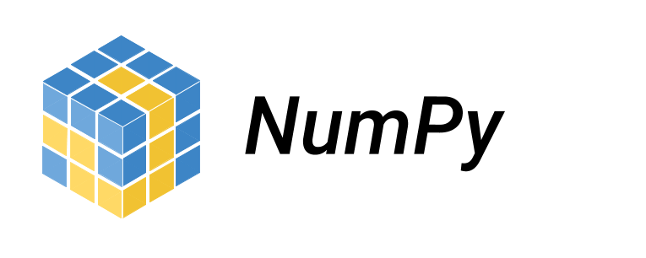


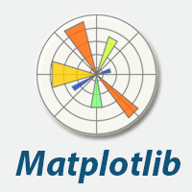

Libraries Used
NumPy
Pandas
Matplotlib
Seaborn
SkLearn

Slide 7
Algorithms Used
Decision Tree Algorithm:
A decision tree is a non-parametric supervised learning algorithm, which is utilized for both classification and regression tasks. It has a hierarchical, tree structure, which consists of a root node, branches, internal nodes and leaf nodes.
K-Nearest Neighbor(KNN):
The k-nearest neighbors algorithm, also known as KNN or k-NN, is a non-parametric, supervised learning classifier, which uses proximity to make classifications or predictions about the grouping of an individual data point. While it can be used for either regression or classification problems, it is typically used as a classification algorithm, working off the assumption that similar points can be found near one another

Slide 8
Logistic Regression:
Logistic regression estimates the probability of an event occurring, such as voted or didn’t vote, based on a given dataset of independent variables. Since the outcome is a probability, the dependent variable is bounded between 0 and 1. In logistic regression, a logit transformation is applied on the odds—that is, the probability of success divided by the probability of failure.

Slide 9
Preprocessing the Data
First of all we cleaned the dataset by removing all the irrelevant features.
Then we split the dataset for training and testing using train_test_split.
We kept training inputs and outputs in X_train and Y_train respectively and for testing we used X_test and Y_test.
In KNN algorithm we transormed the data to Standart Scaler Form which further improved the accuracy of the model.

Slide 10
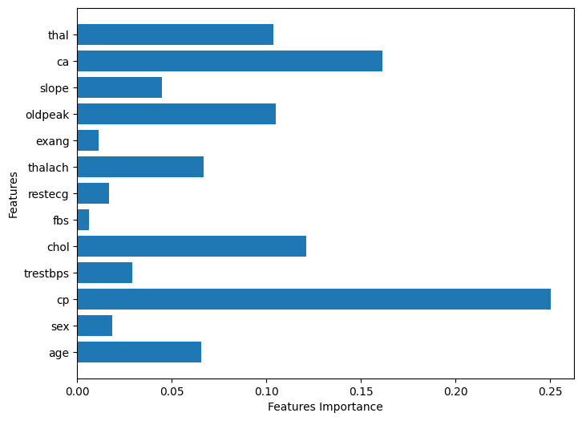
Things Analyzed from Datasets
We analyzed the datasets using various Python libraries and found the found the features which are most likely to affect the results of the dataset.
For e.g. while analyzing the heart disease data set we found the following features affect the most in the results:

Slide 11
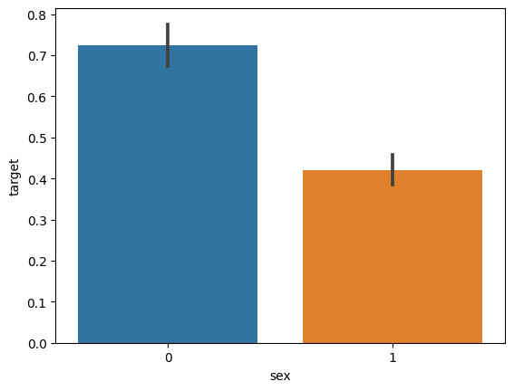
Things Analyzed from Datasets
We also observed that people of which gender are more likely to be affected by that disease :
Analysis of heart disease dataset

Slide 12
Prediction
We predicted the models on y_test and worked towards improving the accuracy of the models.
In KNN we ran a script for finding which k_neighbor value will give us best accuracy.
We performed custom data prediction on the models.
We also developed a web app using streamlit which provides the GUI for entering the data and getting results.

Slide 13
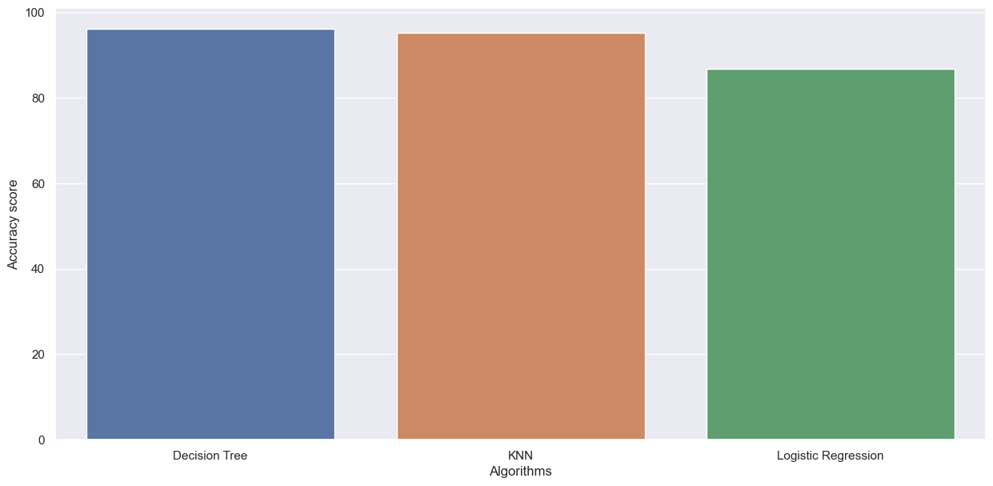
Comparison of different Algorithms
We compared the accuracy of 3 different models and plotted it in a form of bar graph to know which model gives the best accuracy with that particular dataset.

Slide 14
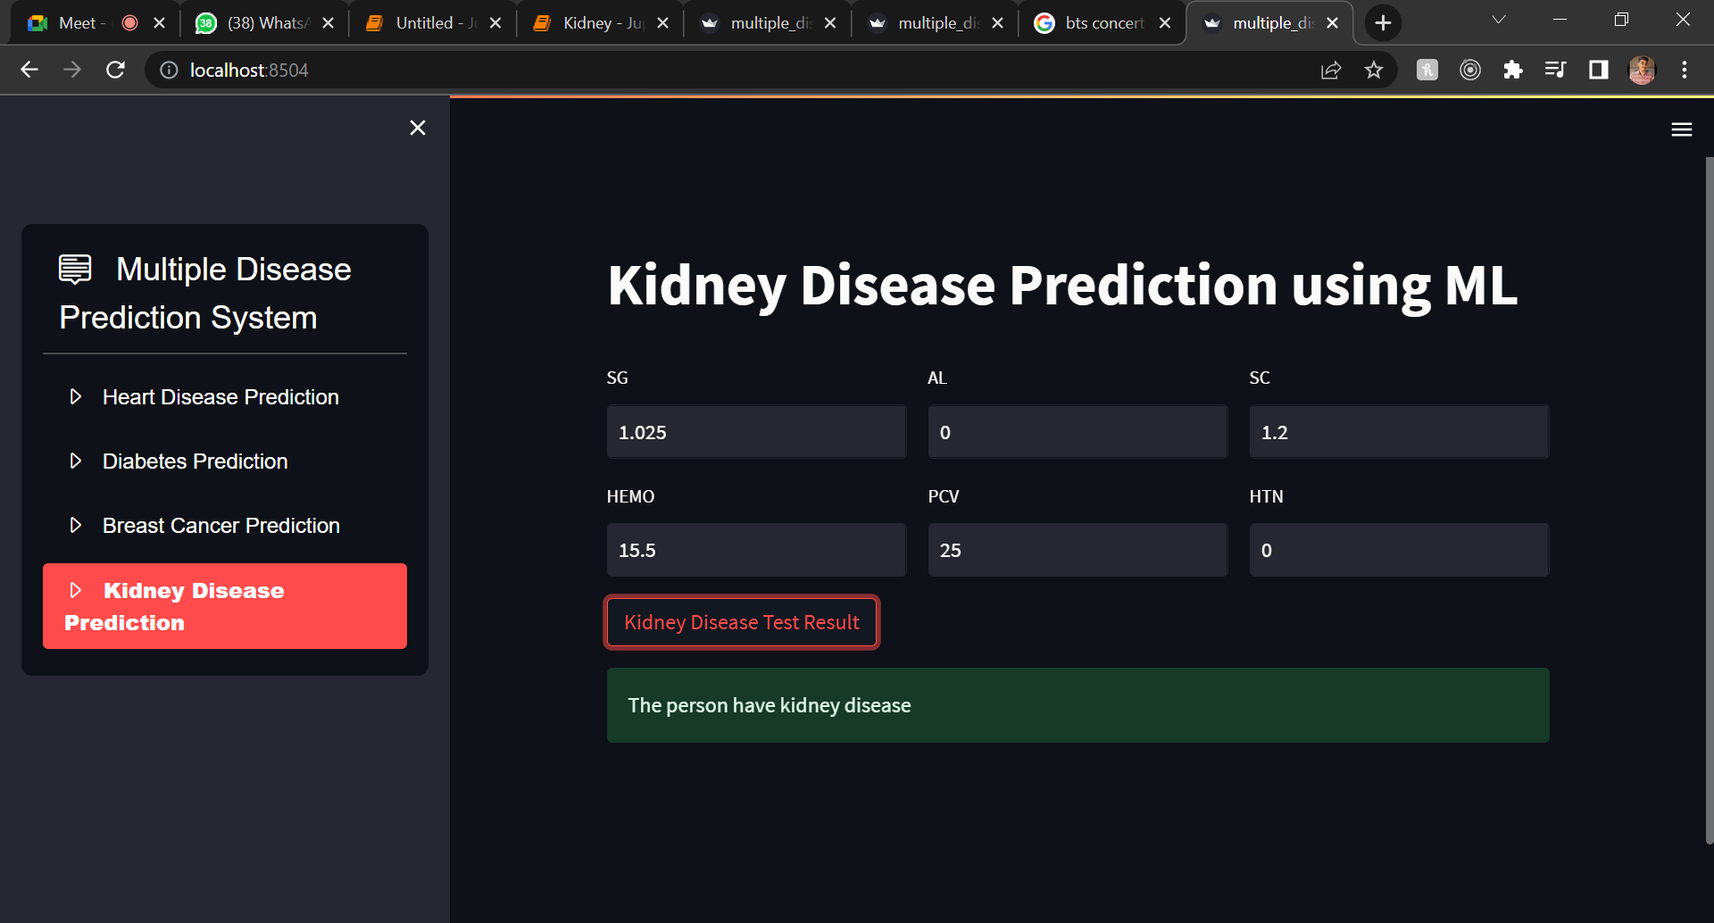
For e.g. in the previous graph we found that Decision Tree gave the best accuracy compared to other models and hence it helped us to use the most accurate model for our web app.

Slide 15
Conclusion
This prediction system helps people to know whether they have a particular disease.
The results are not 100% accurate but they can predict with a pretty decent accuracy that they are having a particular disease or not and based on these results they may further consult a doctor for more accurate diagnosis.
We also developed a web app for providing a better GUI to the users. The link is provided for the same:
https://dwijjoshi-multiple-disease-p-multiple-disease-prediction-3pg0h7.streamlit.app/

